Slide 1


GEN AI USE CASE
September 2023

Slide 2


CODE INTERPRETATION
Code interpretation, also known as code analysis or code understanding, plays a crucial role in software development and various other fields.
It involves the process of comprehending and explaining the functionality, structure, and purpose of a piece of code.
This use case explores how code interpretation can be applied to solve real-world problems and showcases its importance in different domains.
Using Interpreter, the user can get the visual analysis (plots) and even the dataset explanation for the input dataset.

Slide 3
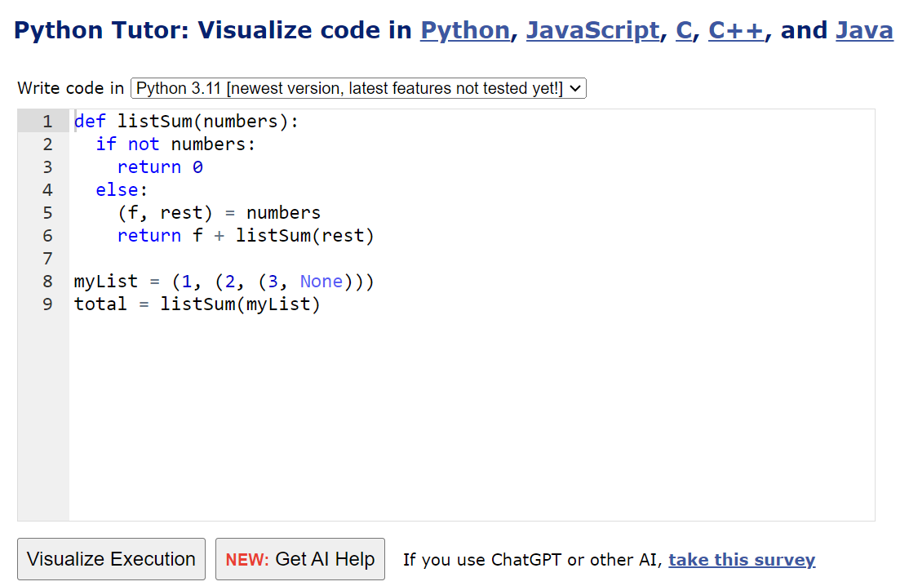
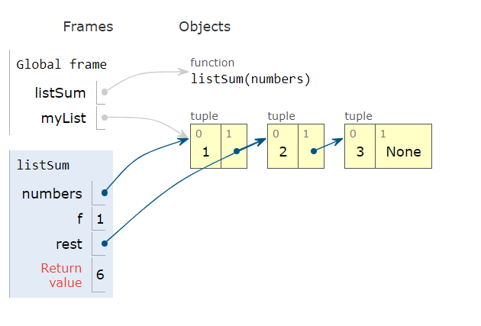
1) PYTHON TUTOR – Code visualiser
This tool helps people overcome a fundamental barrier to learning programming: understanding what happens as the computer executes each line of a program's source code
Using this tool, we can write Python, Java, JavaScript, TypeScript, Ruby, C, and C++ programs in your Web browser and visualize what the computer is doing step-by-step as it executes those programs.
This tool can be locally executed through localhost by cloning the github page - https://github.com/pathrise-eng/pathrise-python-tutor
After cloning the git page, Python visualisations can be ran on the local machine by using the following command
pip install bottle
cd v5-unity/
Python bottle_server.py

Slide 4
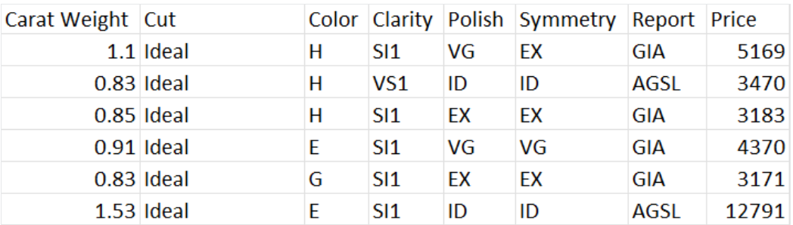
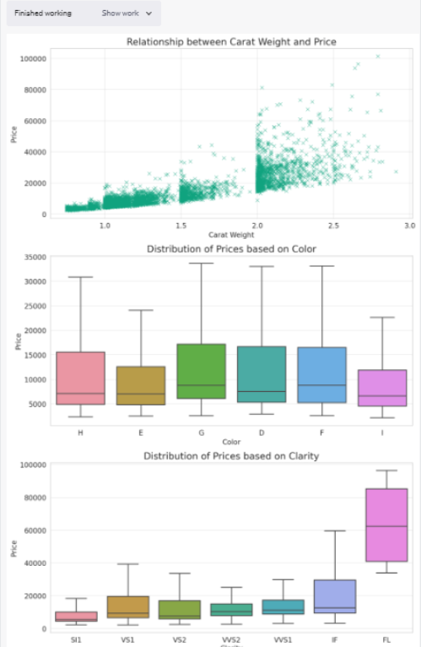
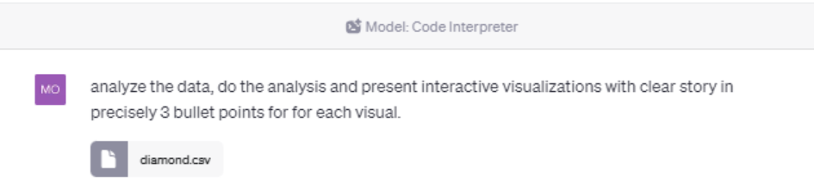
2a) DATA ANALYSIS – Dataset Interpreter
ChatGPT Plus has code interpreter feature using which user can upload data in various file format
User can ask ChatGPT to find something interesting in the input dataset, it can examine information like financial records, health stats, or location details and give insights on the data.
People working in finance have found it useful for tasks like studying stock prices or planning a budget. Researchers are also using this tool to make unique data visualizations.
Example :
INPUT :
OUTPUT
REFERENCE :
https://www.datacamp.com/tutorial/how-to-use-chat-gpt-code-interpreter
https://www.youtube.com/watch?v=R2GHI2IuTMA

Slide 5
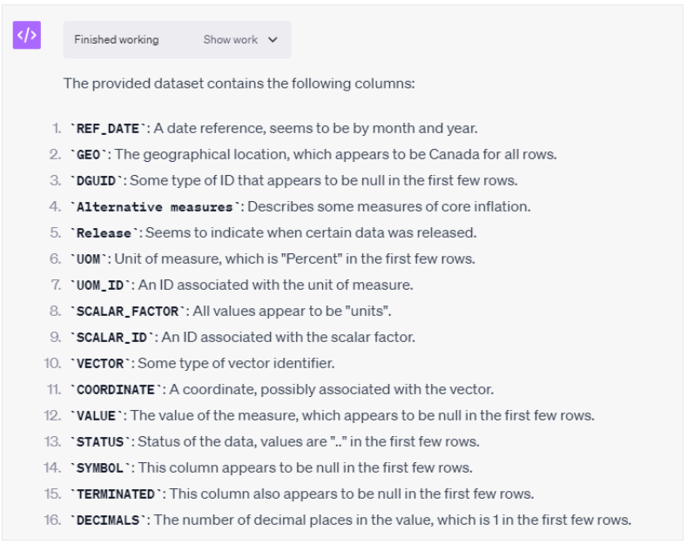
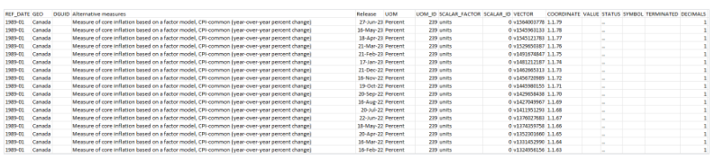
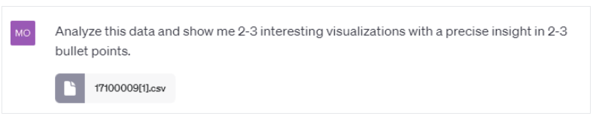
2b) Data Insights on a more complex dataset
OUTPUT : EXPLORING THE DATASET
Upload the dataset
Input prompt
REFERENCE :
https://www.datacamp.com/tutorial/how-to-use-chat-gpt-code-interpreter
https://www.youtube.com/watch?v=R2GHI2IuTMA

